Slide 1
Cooperative Interference Management in Wireless Networks
I-Hsiang Wang
École Polytechnique Fédérale de Lausanne (EPFL)
IE/INC Seminar
Chinese University of Hong Kong, Hong Kong
May 14, 2012
Notes:
Thanks for the nice introduction. It’s my great pleasure to be here. Today I would like to share with you some of my research on cooperative interference management in wireless networks, from an information theoretic point of view.

Slide 2
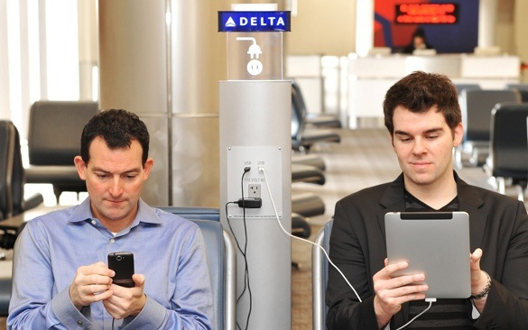
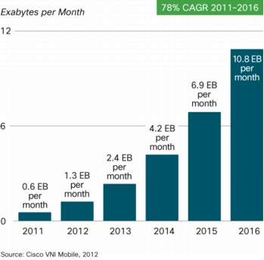
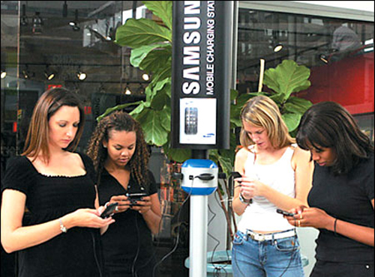

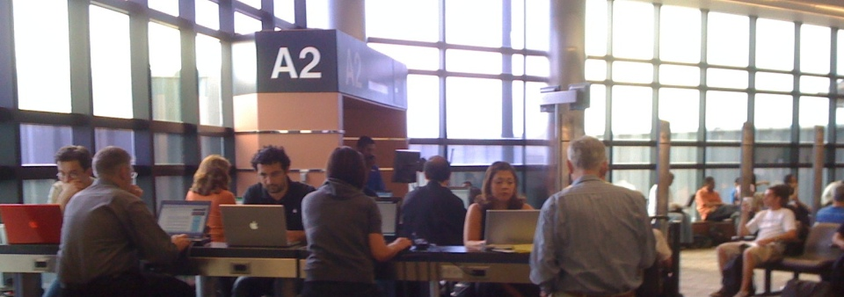
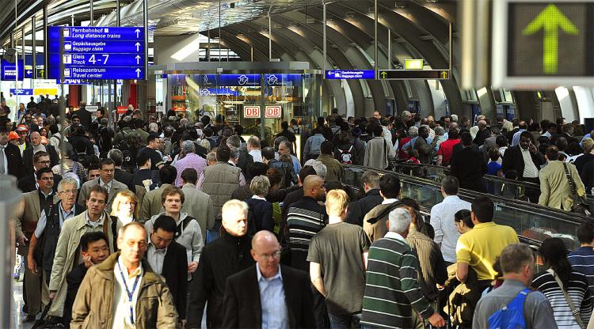
Experience with Wireless?
Monthly Mobile Data Traffic
Skype is
so choppy!
My e-mail won’t refresh…
18X
Why is my
tethered connection
so slow?!
I need
directions now!

Slide 3

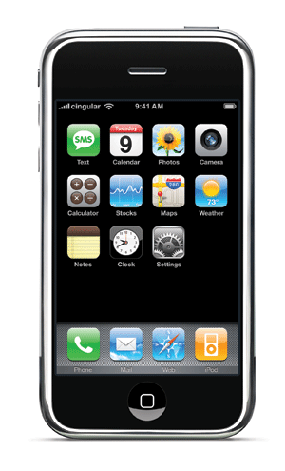
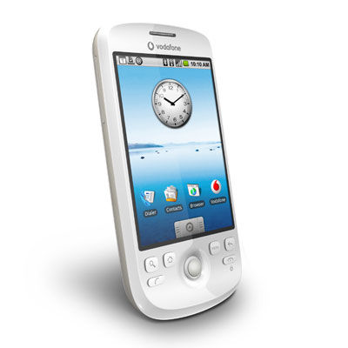
Past Challenges in Wireless
Example: cellular network
1. Fading
✔
2. Multiplexing
(Multiple Access)
✔
Mobile
Past 15 years:
MIMO
Opportunistic communication
Base Station (BS)
Wideband Systems
  CDMA, OFDMA
System Gain:
pertains to point-to-point/single-cell performance
Notes:
Wireless communication has been a thriving industry over the past 15 years. We engineers have taken some challenges in the past to make it successful.
As an example, let’s focus on cellular networks, where mobiles want to communicate with the base station reliably. The first challenge we were faced with, is that the wireless channel is highly unreliable. It is fading over time and frequency. Fading addressed an unique challenge for system engineers to design reliable communication schemes. On the other hand, typically a base station has to serve more than one mobile. Therefore, how to do multiplexing among mobile users economically was another challenge. Over the past 15 years, techniques such as MIMO, where we install multiple antennas onto terminals to exploit spatial diversity, and wideband systems such as CDMA and OFDMA, have been proposed and deployed. As a result, these two challenges have been resolved, and the system performance is boost up so that more users and higher throughout can be supported. However, the system gain from these advances only pertains to point-to-point or single-cell performance.

Slide 4
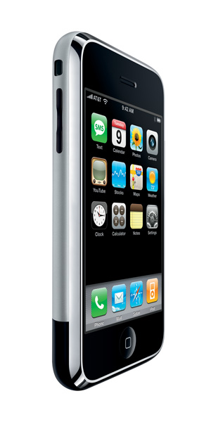
A Current Key Challenge
As # of mobile & BS …
1. Fading
✔
2. Multiplexing
✔
3. Interference
Signal not intended to the receiving terminal (intercell)
Bad news: capacity of two-user interference channel remains open for 35+ years
Performance of today’s wireless system is majorly limited by interference!

Slide 5
Interference: Major Bottleneck
Narrowband system (GSM):
  Orthogonalize it
  Poor frequency reuse; shortage of resource
Wideband system (CDMA, OFDMA):
  Treat it as noise
  Degrades if interferences get strong (cell-boundary users)
Opportunities neglected in traditional paradigm…
Cooperation; cooperative interference management

Slide 6
Opportunities in Cellular Systems
Distributed MIMO
Information theory:
degree-of-freedom gain
power gain
Backhaul
DSL, Optical Fiber, Microwave
virtual
Caveat: cooperation is limited

Slide 7

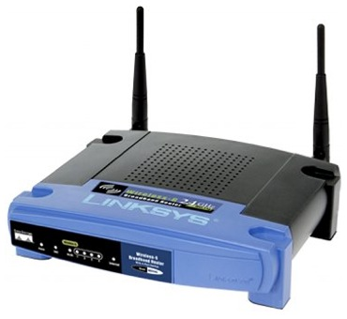
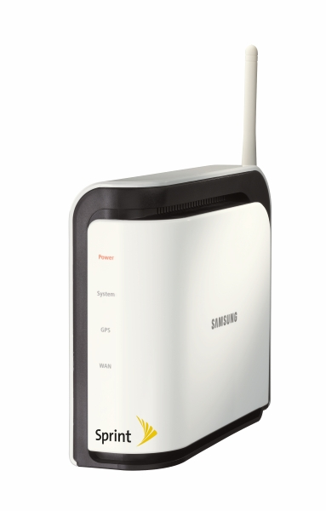
Opportunities in Wireless LAN
Interference
Radios can overhear
Idle or additional devices (femto-cell)
Cooperation
Caveat: cooperation is limited

Slide 8
Short Recap
Interference: currently the major bottleneck
Cooperative interference management
  Opportunities neglected in traditional paradigm
  Cooperation among terminals helps mitigate interference
  The rate at which they cooperate, however, is limited
Fundamental information theoretic question:
How much capacity gain under limited cooperation?
  Answered in this talk!

Slide 9
Overview of Studied Scenarios
Canonical Setting:
Two Transmitters Two Receivers, Orthogonal Coop.
General Setting:
Two Sources Two Destinations
Coop. over Network
Backhaul
Downlink
Uplink
Lens of Information Theory
Wireless
Arbitrary # of Nodes
BS
BS

Slide 10
Rest of this talk
Focus on the canonical two-Tx-two-Rx setting
Approximate characterization of capacity region
Gain from limited cooperation
  Qualitative interpretation
  Quantitative understanding
Optimal scheme in high-SNR regime
Two unicast sessions over layered wireless networks

Slide 11
Gaussian Interference Channel
Gaussian Interference Channel (GIC)
All nodes know the whole channel
  Direct link: Signal-to-Noise Ratio (SNR)
  Cross link: Interference-to-Noise Ratio (INR)
Capacity is open for 35+ years
  Capacity region characterized to within 1 bits/s/Hz [Etkin et.al.’07]

Slide 12
GIC with Limited Cooperation
Out-of-Band Transmitter Cooperation
Out-of-Band Receiver Cooperation
All nodes know the whole channel
Cooperation links are noise-free,
  Orthogonal to each other and the interference channel
  Of finite capacities and respectively

Slide 13
Capacity to within a Bounded Gap
Joint work with David Tse
Rx Cooperation: Capacity region to within 2 bits/s/Hz [W&Tse’09]
Tx Cooperation: Capacity region to within 6.5 bits/s/Hz [W&Tse’10]
The first uniform approximation result on the capacity region of GIC with Rx cooperation or Tx cooperation
As SNR goes to infinity, gap is negligible: Capacity at high SNR!

Slide 14
Nature of the Gain from Coop
Wireless
Receiver Cooperation
Symmetric Case
Wireless
power gain
degree-of-freedom gain
Backhaul
Linear Region
Cooperation is efficient
Saturation Region
Cooperation is inefficient
Focus on the Linear Region

Slide 15
Coop. Efficiency in Int. Mitigation
Corollary (DoF Gain)
Depending on the channel strength, either
One additional coop bit buys one more bit over-the-air, or
Two additional coop bits buy one more bit over-the air
power gain
degree-of-freedom gain
Slope is either 1 or ½, depending on channel strength

Slide 16
High-SNR Approximate Capacity
Capacity per user
The same picture for Tx cooperation!
Normalized Capacity (by the interference-free capacity)
High-SNR Normalized Capacity
Without cooperation [Etkin et.al.’07]
Normalized Backhaul Capacity
With cooperation
Strength of Interference
The same definition for Tx cooperation!

Slide 17
Linear Deterministic Model
✕
Approximate!
Unit Tx power
Unit noise power
✕
✕
✕
✕
✕
✕
(Roughly speaking), # of bits that is above the noise level
Captures the interaction of signals in wireless networks
[Avestimehr et.al.’07]

Slide 18
One Cooperation bit buys one bit
Tx1
Rx1
common
private
Slope = 1
Tx2
Rx2
Two cooperation bits buy two more bits

Slide 19
Two Cooperation bits buy one bit
Tx1
Rx1
Slope = 1/2
Tx2
Rx2
Two cooperation bits buy one more bit

Slide 20
Near Optimal Coding Scheme
Blue: common
Red: private
Superposition coding
  Common-private split facilitates partial interference cancellation
  Private interference is at or below noise level at the unintended receiver
Quantize-Map-Forward
  Quantize at private+noise signal level
  Jointly decode message and quantization codeword

Slide 21
Uplink-Downlink Reciprocity
Primary Downlink Scenario
Channel matrix Hermitian
Swap two cooperation links
Capacity regions are within a bounded gap
Dual Uplink Scenario

Slide 22
Reflections
Multiple Information Flows over Networks
IC with Tx Coop
[W & Tse’10]
IC with Rx Coop
[W & Tse’09]
Just two special cases!
  Techniques in the proofs are tailored for specific problems
Single-flow problem:
  Solved in the linear deterministic scenario, for arbitrary network topology [Avestimehr et.al.’07]
  Max Flow = Min Cut
Is there a common principle/approach to solve a richer set of problems?

Slide 23
Multiple-Unicast Wireless Network
Wireless
Arbitrary # of Nodes
K=1, single unicast [Avestimehr et al.‘07]
  Max-Flow = Min-Cut
  Random linear coding achieves min-cut
Insights from network coding in wired networks
Extends to single multicast

Slide 24
Two Unicast Sessions
Wireless
Wired (integer edge capacity)
Arbitrary # of Nodes
Two Unicast Wired Networks (directed)
  Capacity unknown!
MinCut(s_{i}; d_{i}) = 1: Capacity characterized [Wang & Shroff IT10]
  Cut-set bound is not tight
  Routing or random linear network coding no longer suffice
  Only a bounded # of edges has to take special operations

Slide 25
Two-Unicast Wired Networks
  The region must be one of the two:
  Necessary and sufficient conditions are given

Slide 26
An Analog in Wireless Two-Unicast
Layered linear deterministic network
  MinCut(s_{i}; d_{i}) = 1, i = 1,2
Example
Baseline
Capacity?
Trivial outer bound
Time sharing inner bound
Layer 0
Layer 1
Layer 2

Slide 27
Main Result
Layered linear deterministic network
  MinCut(s_{i}; d_{i}) = 1, i = 1,2
  Characterize the two-unicast capacity region
  Must be one of the following five
Joint work with S. Kamath and D. Tse

Slide 28
Key Idea in the Result
Some nodes are special!
Achievability – all nodes do random linear coding,
Except 4 of these nodes
Outer Bound – suffices to check their properties
No need to check others
Systematic approach to identify them

Slide 29
Conclusion
Cooperative Interference Management
  Capacity characterized approximately
  Linear vs. Saturation Region
  Cooperation Efficiency in Linear Region
    1 Coop bit buys 1 bit over-the-air or
    2 Coop bits buy 1 bit over-the-air
  Insights to cellular system design with limited backhaul
General Two-unicast Wireless Networks
  Layered linear deterministic network, individual min-cut constrained to be 1: Capacity characterized
  General case: open

Slide 30
Thank You!
More details can be found at
http://sites.google.com/site/ihsiangw/
Email: i-hsiang.wang@epfl.ch

